Slide 1
Progress Report 1
Group #1
Glorioso, Jose Miguel
Pino, Alexander
Rosario, Dane Lauren
Tan, Jeremy Marcus

Slide 2
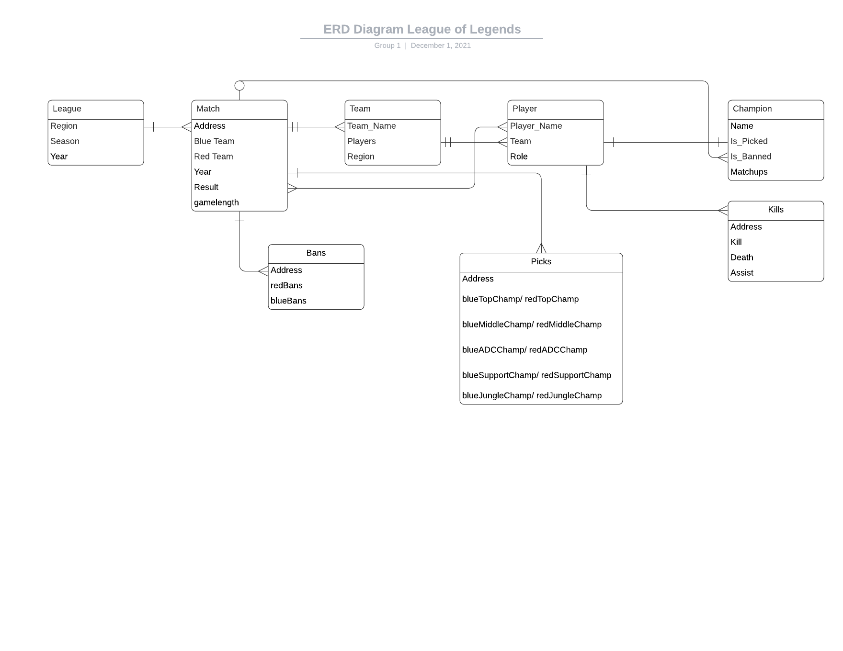
Entity Relationships

Slide 3
Access Patterns
1. Best Players by KDA
2. Champions with the highest win rate
3. Best Bot Lane Duos
4. Most Picked Champions
5. Most Banned Champions
6. Most Picked Champions by player
7. Best Teams and Team Win Rates
8. Average Game Length

Slide 4
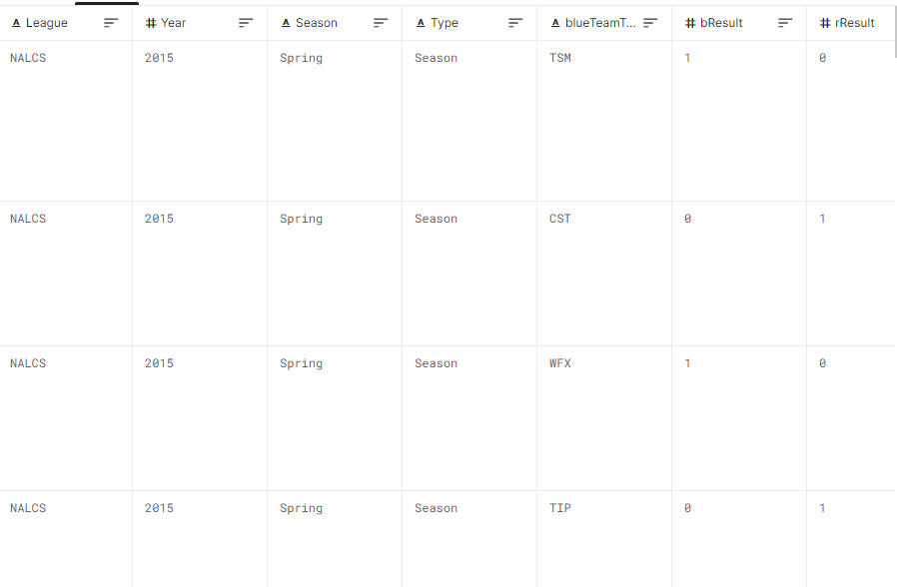
Sample Dataset

Slide 5
Access Patterns Code
Best Players by KDA
$match by player in killer, victim and assist
$group to get the count of kills, death and assist (repeat aggregate 3 times)
create a list of players with their KDA value: K+A/D, then sort
Champions with highest win rate
Create list of champions, with associated matches
Using the win/lose attribute, aggregate win rate.
Create the win rate attribute
Sort champions by win rate

Slide 6
Access Patterns Code
3. Best Combination of Champions (Bottom lane)
$match by a unique duo of champions in the bottom lane (ADC and Support)
Count the number of times a certain bottom duo was picked
Count the number of times the bottom duo won the game
Get the win rate of the bottom duo
Sort the bottom duo by win rate
4. Most Picked Champions
Match the year attribute to a year
Use the $group function to count the the number of times a champion was picked
Create a new attribute for a champion, pick_rate which divides the count by the total number of games in the league for that year
Sort champions by pick_rate

Slide 7
Access Patterns Code
5. Most Banned Champions
Count the total times the champion is banned (count the values from ban_1, ban_2, ban_3)
Count the total matches
Create a function that would take the times a champion is banned divided by the total matches
Create the Ban Rate attribute
Aggregate (Sort by descending order, Project Champion and Ban Rate, and Limit to 5)
6. Most Picked Champions by player (complex)
Create PlayerName attribute (from the blue{Role} + red{Role})
Create PlayerChampion attribute (from the blue{Role}{Champ} + red{Role}{Champ})
Aggregate (Match by PlayerName, Count by PlayerChampion, Sort by descending order, Limit to 5)

Slide 8
Access Patterns Code
7. Team Wins and Win Rates
Idk basta nakuha ko lmao
8. Average Game Length of each year
Create list of matches
Sort games by “gamelength” attribute
find the average game length using the $avg

